Slide 1









Tutorial
The OpenDSS Application
Roger C. Dugan
Sr. Technical Executive rdugan@epri.com
Knoxville, Tennessee 37934 USA
4th International Conference on
Integration of
Renewable and Distributed
Energy Resources
December 6-10, 2010
Albuquerque, NM, USA
Conference Sponsors
Associate Sponsors

Slide 2
Introduction

Slide 3
What is “OpenDSS”?
EPRI’s Distribution System Simulator (DSS)
  Released as open source
  Called “OpenDSS”
Can be found at:
  WWW.SOURCEFORGE.NET
    (Search for OpenDSS)
  Or, e-mail rdugan@epri.com and request a link to the latest OpenDSS on EPRI’s FTP site.

Slide 4
Why was DSS Developed?
For special distribution analysis applications such as DG analysis.
To provide a very flexible research platform.
Fills gaps left by other distribution system analysis tools.
Study new approaches to distribution system analysis.

Slide 5
Why Open Source?
EPRI has made the DSS open source to:
  Cooperate with various Smart Grid open source efforts
    Gridlab-D (from PNL), for example
  To encourage new advancements in distribution system analysis
  To promote grid modernization/Smart Grid efforts by providing researchers and consultants with a tool to evaluate advanced concepts
  Expand the pool of Smart Grid technology resources available to EPRI members

Slide 6
DSS Background
Under development for more than 13 Years
  Started at Electrotek Concepts in 1997
  Purchased by EPRI in 2004
Objectives in 1997
  Support all distribution planning aspects of distributed generation
  Implement a flexible research platform
  Incorporate object-oriented data ideas
Key Future work
  Smart Grid research and demonstrations
  DSE for North American Systems
  Dense urban networks
  Reliability methods research

Slide 7
Distribution System Simulator (DSS)
Designed to simulate utility distribution systems
  In arbitrary detail
  For most types of analyses related to distribution planning.
It performs its analysis types in the frequency domain,
    Power flow,
    Harmonics, and
    Dynamics.
  It does NOT perform electromagnetic transients (time domain) studies.

Slide 8
Time- and Location-Dependent Benefits
The OpenDSS was designed from the beginning to capture both
  Time-specific benefits and
  Location-specific benefits
Needed for
  DG analysis
  Renewable generation
  Energy efficiency analysis
  PHEV and EV impacts
  Other proposed capacity enhancements that don’t follow typical loadshapes

Slide 9
Time- and Location-Dependent Benefits
Most traditional distribution system analysis programs
  Designed to study peak loading conditions
  Capture mostly location-specific benefits
  Ignores time; Assumes resource is available
  This gets the wrong answer for many DG, energy efficiency, and Smart Grid analyses
Must do time sequence analysis to get the right answer
  Over distribution planning area

Slide 10
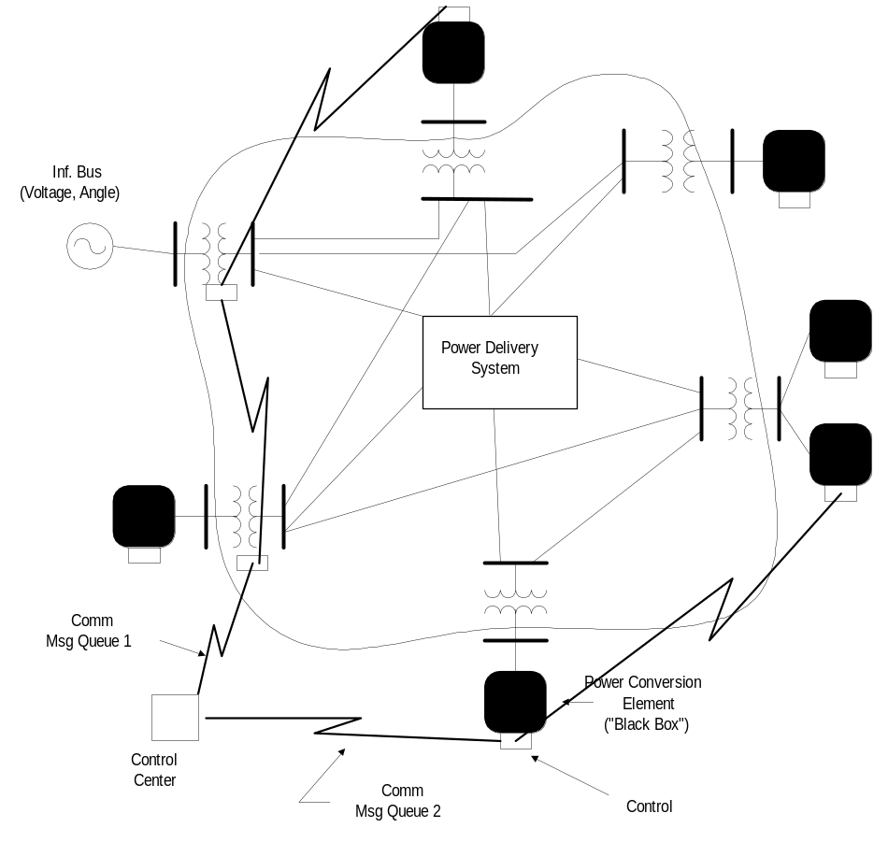
Overall Model Concept

Slide 11
Examples of Advanced OpenDSS Applications
(other than basic multi-phase power flow)
Neutral-to-earth (stray) voltage simulations.
Loss evaluations due to unbalanced loading.
Development of DG models for the IEEE Radial Test Feeders.
High-frequency harmonic and interharmonic interference.
Losses, impedance, and circulating currents in unusual transformer bank configurations.
Transformer frequency response analysis.
Distribution automation control algorithm assessment.
Impact of tankless water heaters on flicker and distribution transformers.
Wind farm collector simulation.
Wind farm impact on local transmission.
Wind generation and other DG impact on switched capacitors and voltage regulators.
Open-conductor fault conditions with a variety of single-phase and three-phase transformer connections.

Slide 12
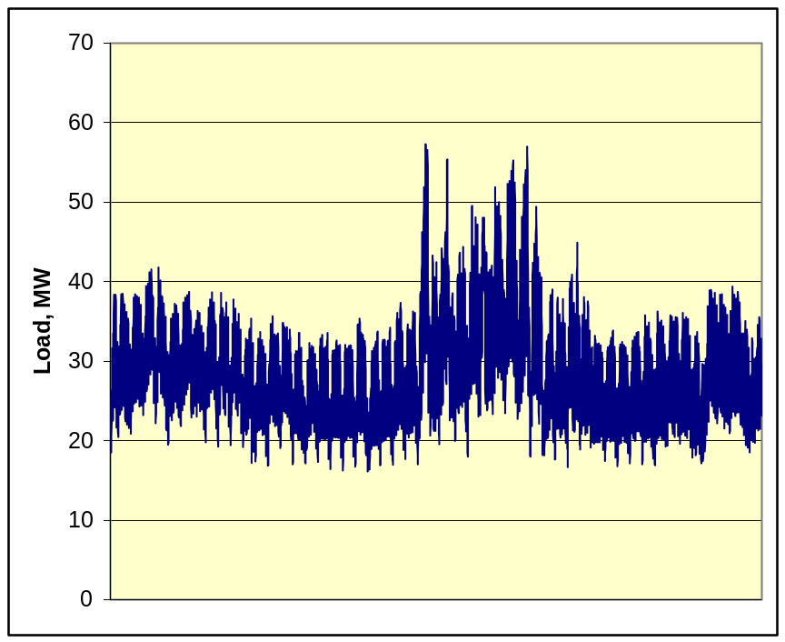
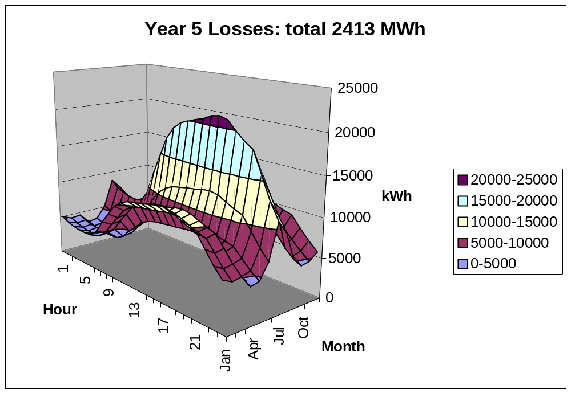
Computing Annual Losses
Peak load losses are not necessarily indicative of annual losses

Slide 13
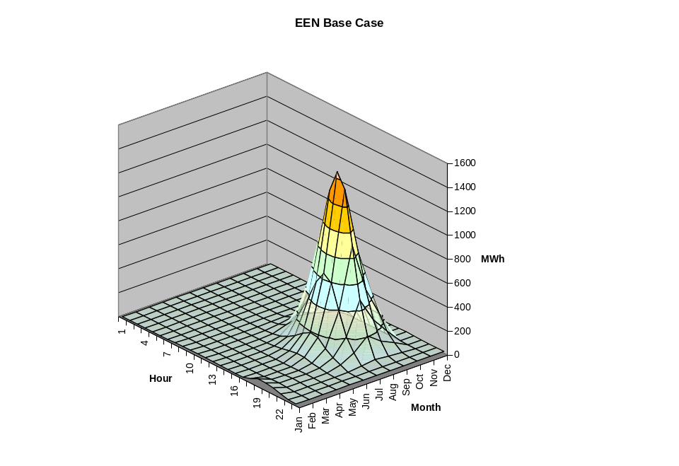
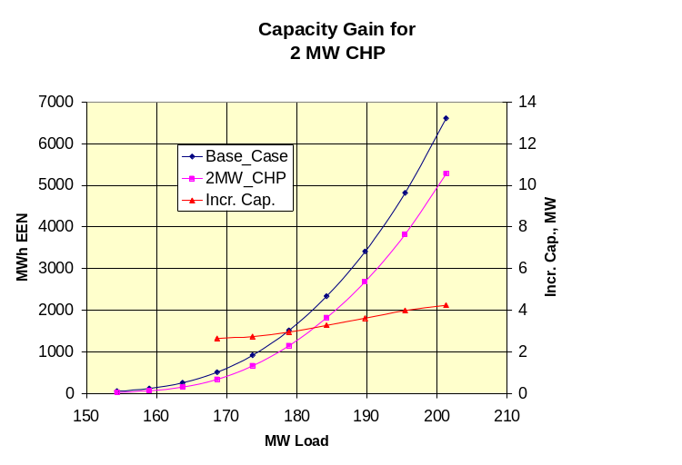
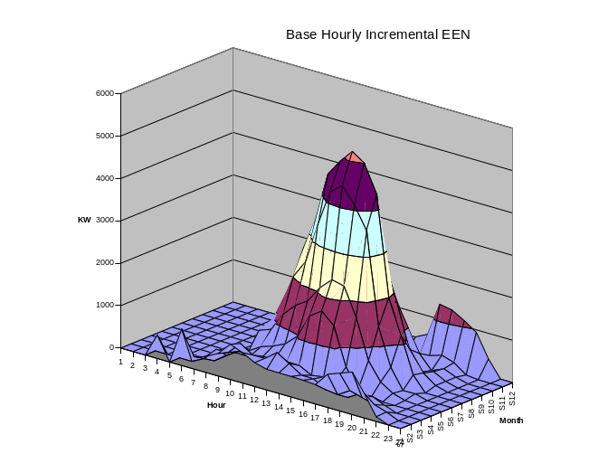
Using DSS to Determine Incremental Capacity of DG
“Needle” Peaking System
“How much more power can be served at the same risk of unserved energy?”
Broad Summer Peaking System

Slide 14
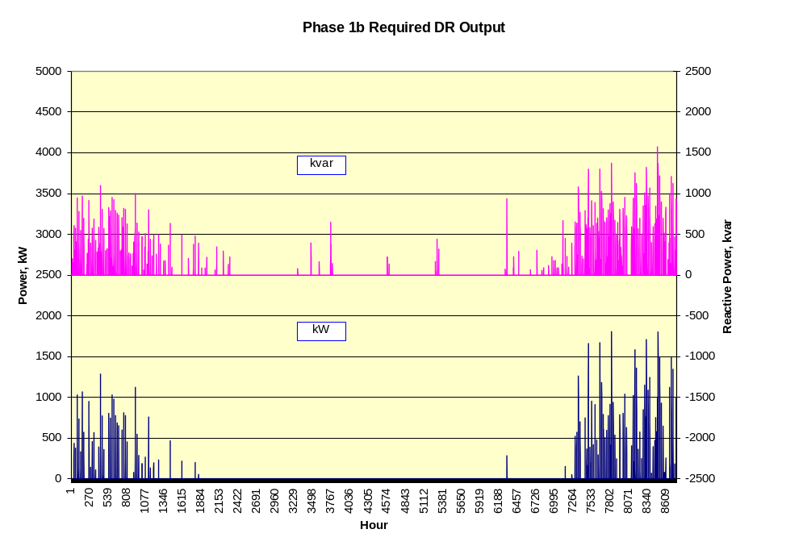
DG Dispatch

Slide 15
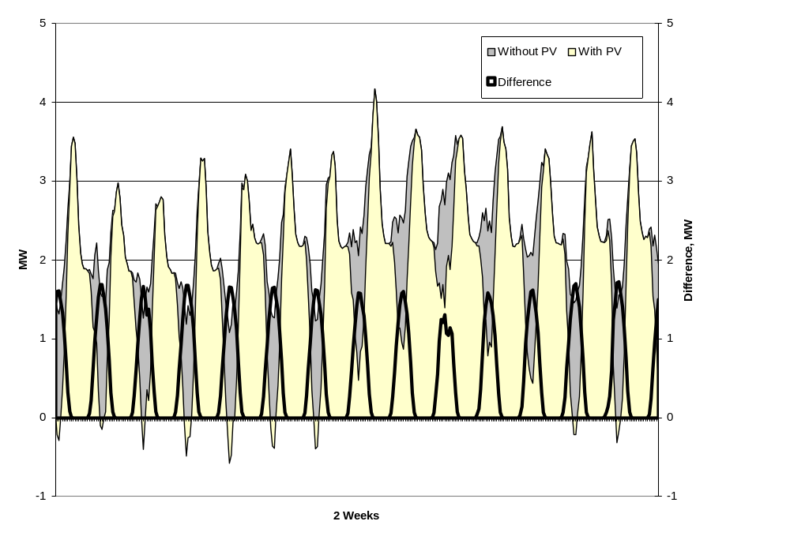
Solar PV Simulation – 1-hr Data

Slide 16
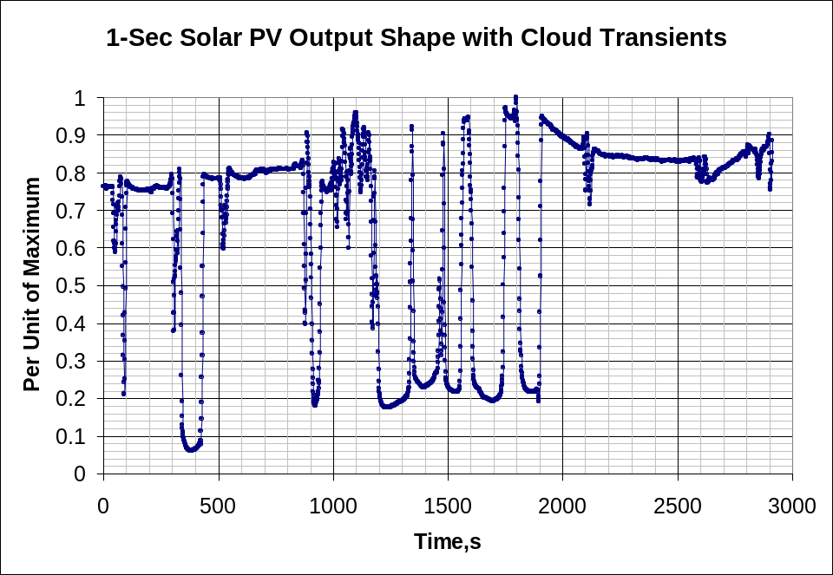
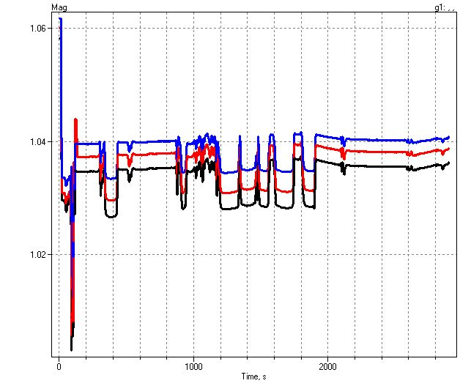
1-sec Solar Data – Cloud Transients
Impact on Feeder Voltage

Slide 17
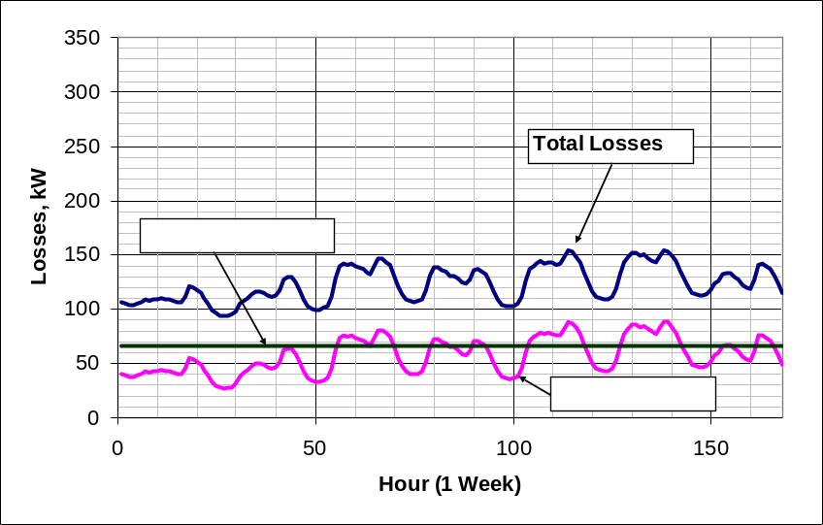
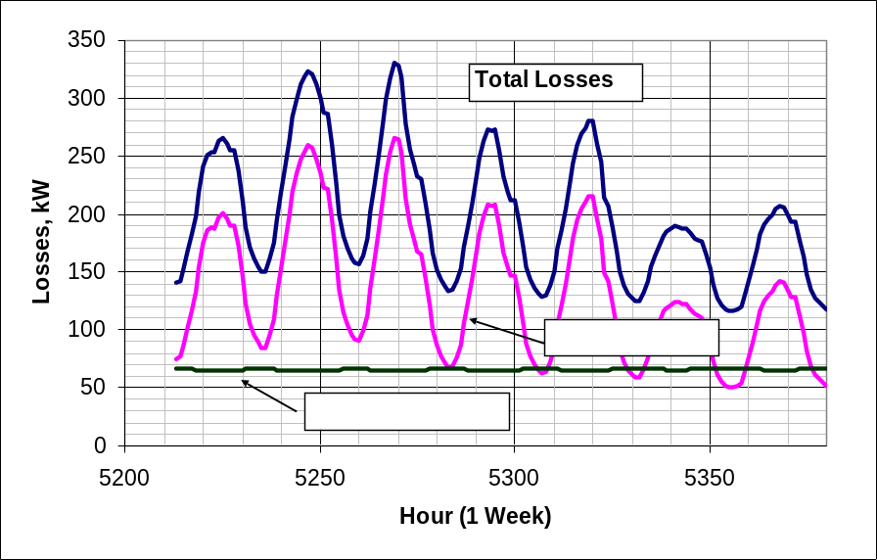
Power Distribution Efficiency
Peak Load Week
Light Load Week

Slide 18
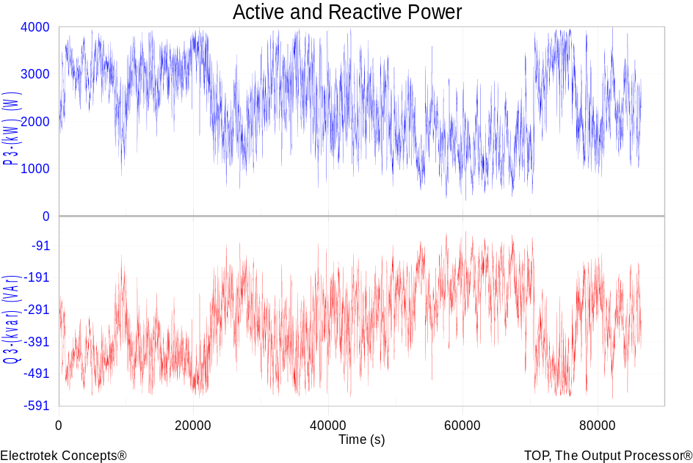
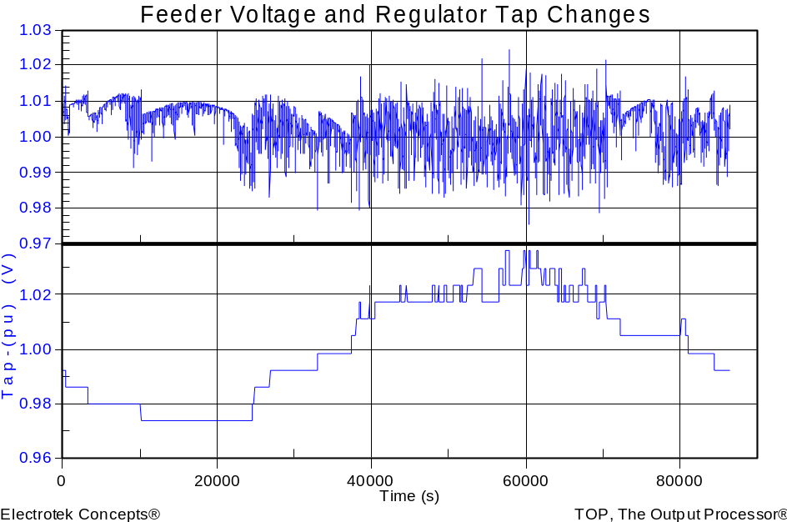
Wind Plant 1-s Simulation
Notes:
The plot you see to the right is a sample case study we did where a developer wanted to install 3 750kW turbines at the end of a 10-mile distribution feeder. Along the feeder was a voltage regulator and large intermittent load. The concern we had was the impact the turbine output fluctuations would have on the flicker, regulator action, as well as the voltage profile along the feeder. Utilizing software that Electrotek had developed, specifically the Distribution System Simulator, or DSS,, minor modifications were made that allowed us to simulate the wind plant fluctuation impact over time, thus giving us the ability to address the concerns at hand.
The plot you see to the right is simulation output from the DSS, over a time horizon of ~ 4 minutes. The three turbines were modeled explicitly, along with the 5-step switched capacitor banks connected to each turbine as well as the voltage regulator upline from the wind plant. This software allows us to make recommendations to the utility and/or wind plant developer regarding modifications necessary, if any, to allow for the wind plant to have minimal impact on the distribution feeder and surrounding customers, or perhaps even improve feeder performance.
We also utilize this software for estimating flicker according the IEC standard 1400-21. The software, along with data specific to the turbine being considered allows one to estimate the flicker impact BEFORE the turbine is installed.

Slide 19
Broadband Driving Point Admittance
0.035
0.03
0.025
0.02
Siemens
|Y|
0.015
0.01
0.005
0
0
100000
200000
300000
400000
500000
Frequency, Hz

Slide 20
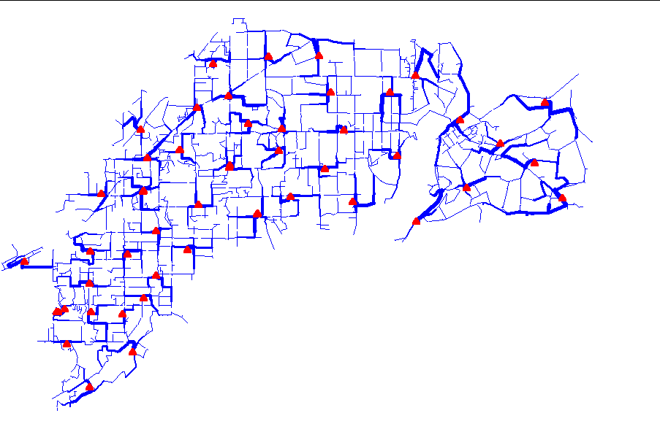
Power Flow Visualization

Slide 21
Getting Started
Installation and Basic Usage

Slide 22
SourceForge.Net Links for OpenDSS
OpenDSS Download Files:
  http://sourceforge.net/projects/electricdss/files/
Main Page in Wiki
  http://sourceforge.net/apps/mediawiki/electricdss/index.php?title=Main_Page
Top level of Main Repository
  http://electricdss.svn.sourceforge.net/viewvc/electricdss/
Source Code
  http://electricdss.svn.sourceforge.net/viewvc/electricdss/Source/
Examples
  http://electricdss.svn.sourceforge.net/viewvc/electricdss/Distrib/Examples/
IEEE Test Cases
  http://electricdss.svn.sourceforge.net/viewvc/electricdss/IEEETestCases/

Slide 23
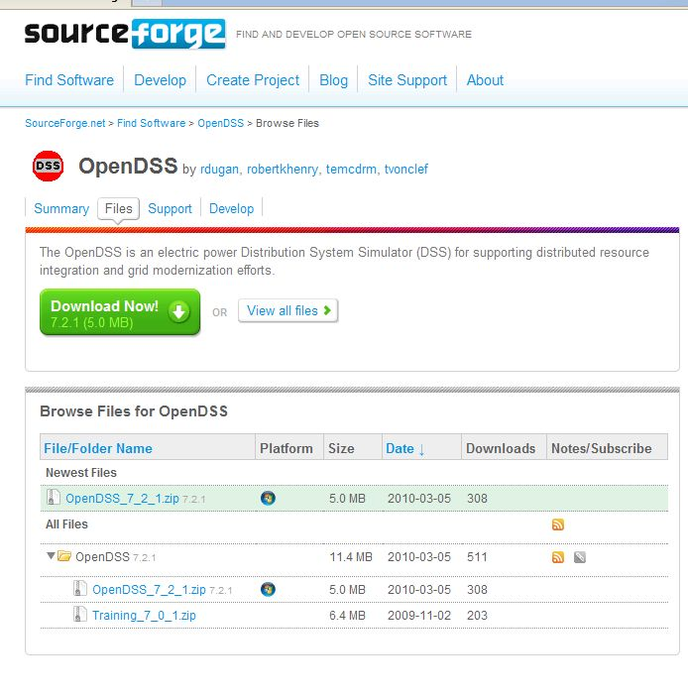
Release File Download Page
This is a Release Version

Slide 24
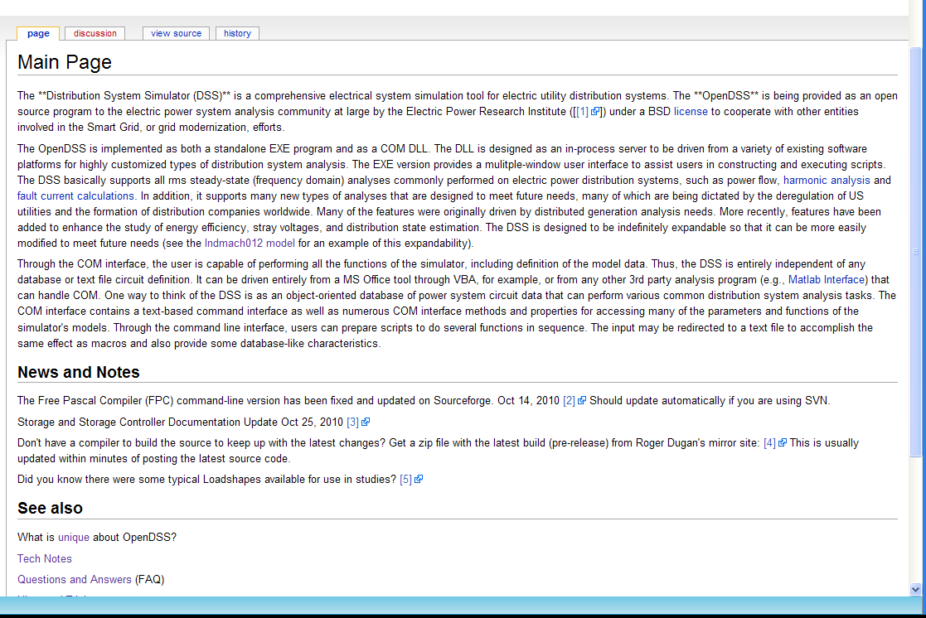
Wiki Home Page

Slide 25
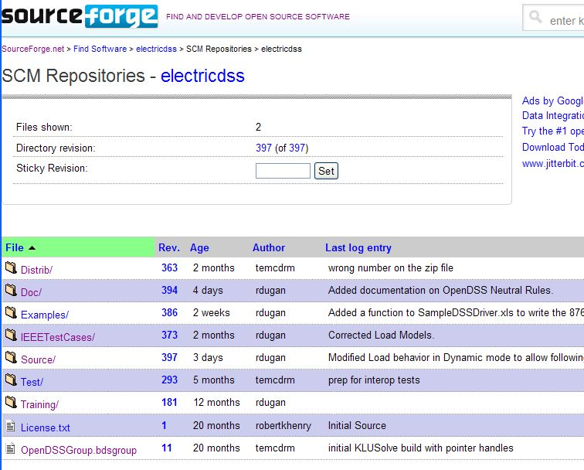
Repository on SourceForge.Net

Slide 26
Release Versions Vs. Source Code
Release versions are posted irregularly on SourceForge
You can keep up with the latest changes by accessing the source code and building the latest version
Latest builds are also posted on an EPRI FTP site
  Request a link from EPRI (see Wiki News and Notes)
Compilers
  Delphi 2010 - This is what we use for development
    Delphi 2007 and 2009 also worked last time we tried
  Free Pascal (with limitations) -www.freepascal.org

Slide 27
Accessing the SourceForge.Net Source Code Repository with TortoiseSVN
Install a 32-bit TortoiseSVN client from tortoisesvn.net/downloads.
Recommendation:
  From the TortoiseSVN General Settings dialog and click the last check box, to use "_svn" instead of ".svn" for local working directory name.
  Then, to grab the files from SourceForge:
  1 - create a clean directory such as "c:\opendss"
  2 - right-click on it and choose "SVN Checkout..." from the menu
  3 - the repository URL is
    http://electricdss.svn.sourceforge.net/svnroot/electricdss
  Change the checkout directory if it points somewhere other than what you want.

Slide 28
Program Files
OpenDSS.EXE Standalone EXE
OpenDSSEngine.DLL In-process COM server
KLUSolve.DLL Sparse matrix solver
DSSgraph.DLL DSS graphics output
Copy these files to the directory (folder) of your choice
  Typically c:\OpenDSS or c:\Program Files\OpenDSS
If you intend to drive OpenDSS from another program, you will need to register the COM server
    Some programs require this !!

Slide 29
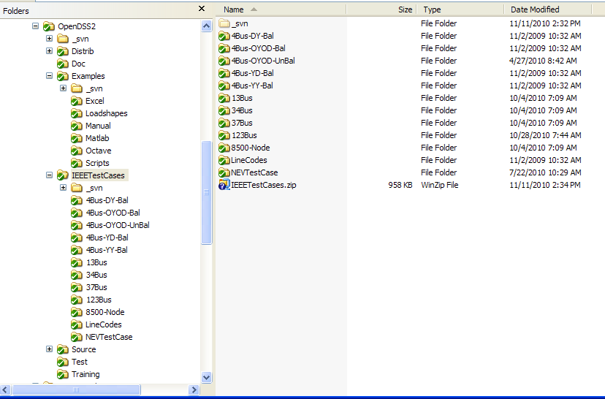
OpenDSS Folders

Slide 30
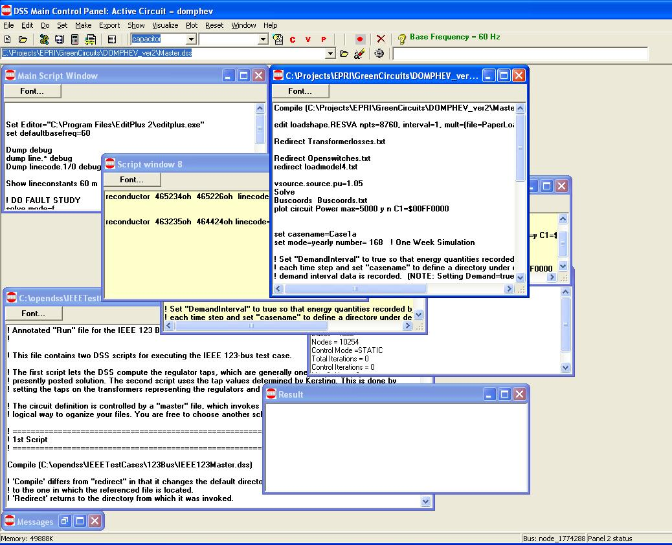
OpenDSS Standalone EXE User Interface
Multiple script windows
Any script window may be used at any time.

Slide 31
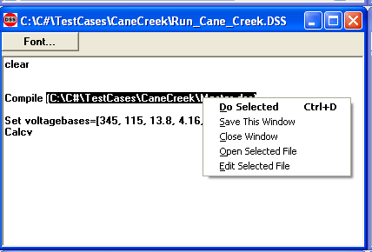
Executing Scripts in the Stand-alone EXE
Select all or part of a line
Right-Click to get this pop-up menu
DSS executes selected line or opens selected file name
Any script window may be used at any time.

Slide 32
DSS Structure
Scripts
Main Simulation Engine
COM Interface
User-Written DLLs
Scripts, Results

Slide 33
DSS Object Structure
DSS Executive
Commands
Options
Circuit
Solution
V
[Y]
I
PDElement
PCElement
Controls
Meters
General
Line
Transformer
Capacitor
Reactor
Load
Generator
Vsource
Isource
Storage
RegControl
CapControl
Relay
Reclose
Fuse
Monitor
EnergyMeter
Sensor
LineCode
LineGeometry
WireData
LoadShape
GrowthShape
Spectrum
TCCcurve
XfmrCode

Slide 34
DSS Class Structure
Instances of Objects of this class
Class
Object 1
Property Definitions
Property Values
Methods
Class Property Editor
Yprim
Collection Manager
States
Object n
Property Values
Methods
Yprim
States

Slide 35
Scripting Basics
Syntax and organizing your scripts

Slide 36
Scripting
OpenDSS is a scriptable solution engine
Scripts
  Series of commands
  From text files
  From edit forms in OpenDSS.EXE
  From another program through COM interface
    e. g., This is how you would do looping
Scripts define circuits
Scripts control solution of circuits
Scripts specify output, etc.

Slide 37
Command Syntax
Command parm1, parm2 parm3 parm 4 ….
Parameters may be positional or named (tagged).
If named, an "=" sign is expected.
  Name=value (this is the named form)
  Value (value alone in positional form)
For example, the following two commands are equivalent:
New Object="Line.First Line" Bus1=b1240 Bus2=32 LineCode=336ACSR, …
  New “Line.First Line”, b1240 32 336ACSR, …
Comma or white space

Slide 38
Delimiters
Array or string delimiter pairs: [ ] , { },( ),“ “,‘ ‘
Matrix row delimiter: |
Value delimiters: , (comma)
any white space (tab or space)
Class, Object, Bus, or Node delimiter: . (period)
Keyword / value separator: =
Continuation of previous line: ~ (More)
Comment line: //
In-line comment: !
Query a property: ?

Slide 39
Array and Matrix Parameters
Array
  kvs = [115, 6.6, 22]
  kvas=[20000 16000 16000]
Matrix
  (3x3 matrix)
    Xmatrix=[1.2 .3 .3 | .3 1.2 3 | .3 .3 1.2]
  (3x3 matrix – lower triangle)
    Xmatrix=[ 1.2 | .3 1.2 | .3 .3 1.2 ]

Slide 40
Arrays from Files
Mult=[1, 2, 3, 4, 5, ..etc…]
Mult=[file=myfile.txt]
Mult=[dblfile=myfile.dbl]
Mult=[sngfile=mufile.sng]
See URL:
http://sourceforge.net/apps/mediawiki/electricdss/index.php?title=TechNote_New_ways_to_import_loadshapes

Slide 41
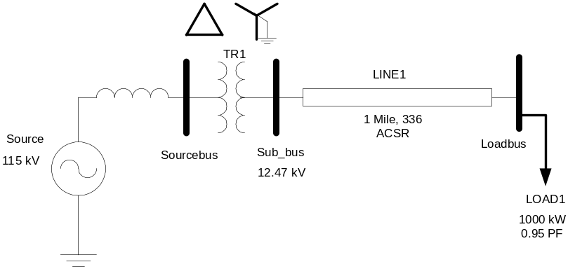
A Basic Script (Class Exercise)
New Circuit.Simple ! Creates voltage source (Vsource.Source)
Edit Vsource.Source BasekV=115 pu=1.05 ISC3=3000 ISC1=2500 !Define source V and Z
New Transformer.TR1 Buses=[SourceBus, Sub_Bus] Conns=[Delta Wye] kVs= [115 12.47]
~ kVAs=[20000 20000] XHL=10
New Linecode.336ACSR R1=0.058 X1=.1206 R0=.1784 X0=.4047 C1=3.4 C0=1.6 Units=kft
New Line.LINE1 Bus1=Sub_Bus Bus2=LoadBus Linecode=336ACSR Length=1 Units=Mi
New Load.LOAD1 Bus1=LoadBus kV=12.47 kW=1000 PF=.95
Solve
Show Voltages
Show Currents
Show Powers kVA elements

Slide 42
Circuit
New Circuit.Simple ! (Vsource.Source is active circuit element)
Edit Vsource.Source BasekV=115 pu=1.05 ISC3=3000 ISC1=2500
Vsource.Source
SourceBus
Source
115 kV, 1.05 pu
115
kV
Short Circuit Impedance (a matrix) that yields 3000A 3-ph fault current and 2500A 1-ph fault current.
One-Line Diagram
(default is 3-phase wye-grd source)

Slide 43
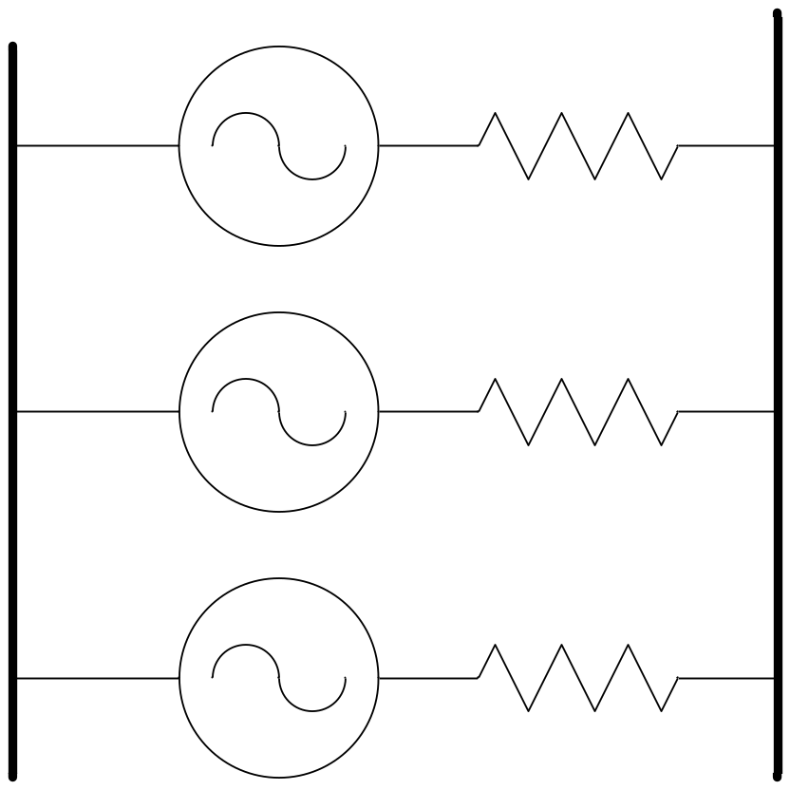
Vsource Element Note
Vsource is actually a Two-terminal Device
  2nd terminal defaults to connected to ground (0V)
  But you can connect it between any two buses
    Comes in handy sometimes
Conceptually a Thevinen equivalent
  Short circuit equivalent
  Converted to a Norton equivalent internally

Slide 44
20 MVA Substation Transformer
TR
SourceBus
1
Sub_Bus
Defining Using Arrays
Defining Winding by Winding
New Transformer.TR1 Phases=3 Windings=2
~ Buses=[SourceBus, Sub_Bus]
~ Conns=[Delta Wye]
~ kVs= [115 12.47]
~ kVAs=[20000 20000]
~ XHL=10
New Transformer.TR1 Phases=3 Windings=2 XHL=10
~ wdg=1 bus=SourceBus Conn=Delta kV=115 kVA=20000
~ wdg=2 bus= Sub_Bus Conn=wye kV=12.47 kVA=20000
2 Ways to Define

Slide 45
The Line
Sub_Bus
LoadBus
LINE
1
1
Mile
,
336
New Linecode.336ACSR R1=0.058 X1=.1206 R0=.1784 X0=.4047 C1=3.4 C0=1.6 Units=kft
New Line.LINE1 Bus1=Sub_Bus Bus2=LoadBus Linecode=336ACSR Length=1 Units=Mi
Line objects may also be defined by Geometries and using matrices

Slide 46
The Load
Loadbus
LOAD
1
1000
kW
0
.
95
PF
New Load.LOAD1 Bus1=LoadBus kV=12.47 kW=1000 PF=.95
For 3-phase loads, use L-L kV and total kW
For 1-phase loads, typically use L-N kV and total kW unless Delta-connected; Then use L-L kV.

Slide 47
Modeling Basics
Circuit Elements, Buses, etc

Slide 48
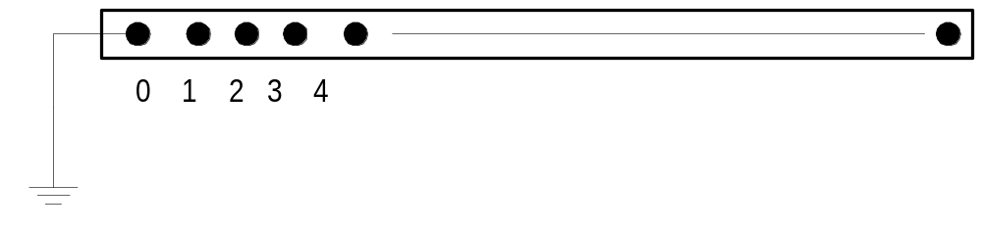
DSS Bus Model
Referring to Buses and Nodes
Bus1=BusName.1.2.3.0
(This is the default for a 3-phase circuit element)
Shorthand notation for taking the default
Bus1=BusName
Note: Sometimes this can bite you (e.g. – Transformers, or capacitors with ungrounded neutrals)

Slide 49
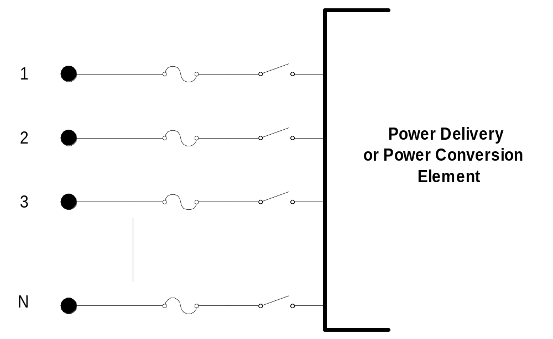
DSS Terminal Definition

Slide 50
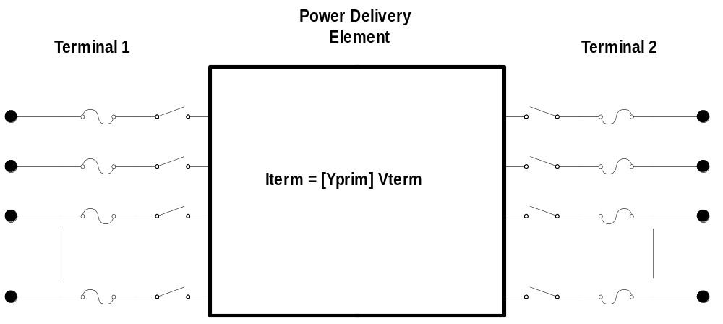
Power Delivery Elements
(PD Elements)

Slide 51
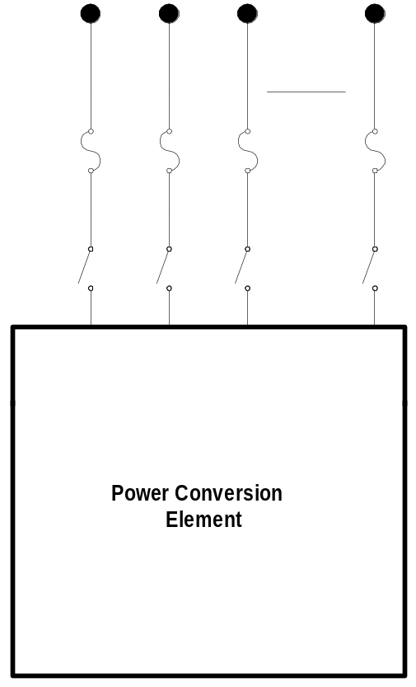

Power Conversion Elements
(PC Elements)
I_{Term}(t) = F(V_{Term}, [State], t)

Slide 52
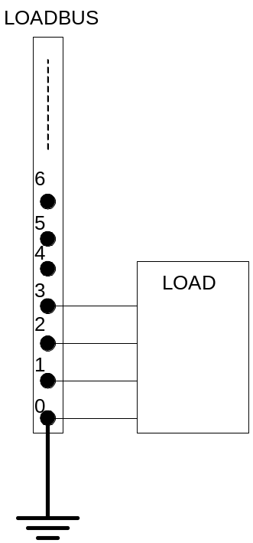
Specifying Bus Connections
Shorthand (implicit)
  New Load.LOAD1 Bus1=LOADBUS
    Assumes standard 3-phase connection by default

Slide 53
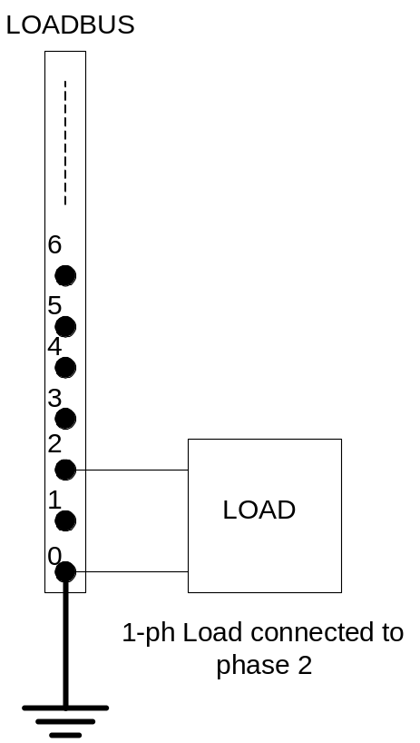
Specifying Bus Connections
Explicit
  New Load.LOAD1 Bus1=LOADBUS.1.2.3.0
      Explicitly defines which node
  New Load.1-PHASELOAD Phases=1 Bus1=LOADBUS.2.0
      Connects 1-phase load to phase 2 and ground

Slide 54
Specifying Bus Connections
Default Bus templates
    Node connections assumed if not explicitly declared
  Element declared Phases=1
    … LOADBUS.1.0.0.0.0.0.0.0.0.0. …
  Element declared Phases=2
    … LOADBUS.1.2.0.0.0.0.0.0.0.0. …
  Element declared Phases=3
    … LOADBUS.1.2.3.0.0.0.0.0.0.0. …

Slide 55
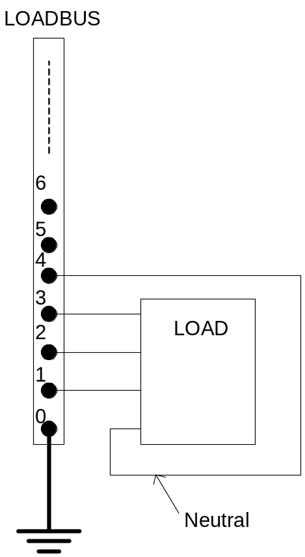
Specifying Bus Connections
  Ungrounded-Wye Specification
  Bus1=LOADBUS.1.2.3.4 (or some other unused Node number)

Slide 56
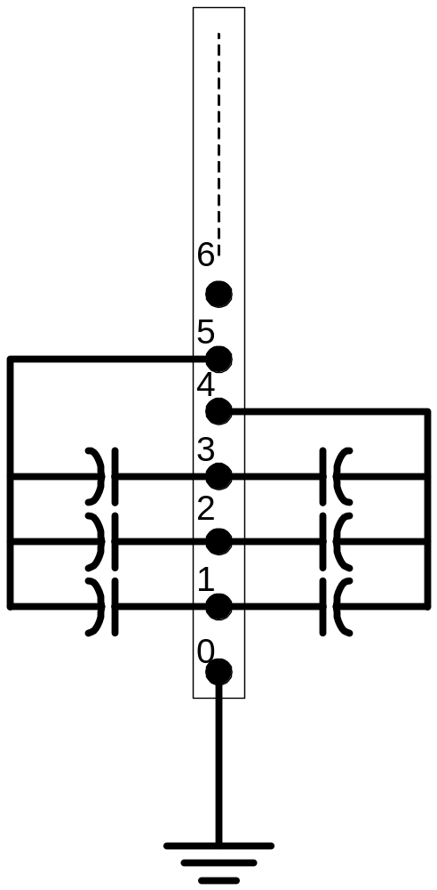
Specifying Two Ungrounded-Wye Capacitors on Same Bus
MyBus
… Bus1=MyBus.1.2.3 Bus2=MyBus.5.5.5
Neutrals are not connected to each other!
… Bus1=MyBus Bus2=MyBus.4.4.4

Slide 57
Circuit Elements are Connected together at the Nodes of Buses
MyBus
3
2
1
0
. . . Bus2 = MyBus.2.1.3.0 . . .
. . . Bus1 = MyBus . . .
(take the default)
(Explicitly define connections)
DSS Convention: A Terminal can be connected to only one Bus. You can have any number of Nodes at a bus.

Slide 58
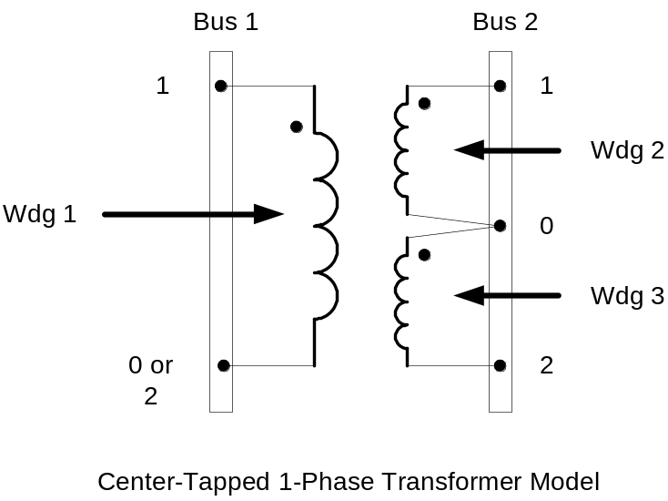
Example: Connections for 1-Phase Residential Transformer
! Line-to-Neutral Connected 1-phase Center-tapped transformer
New Transformer.Example_1-ph phases=1 Windings=3
! Typical impedances for small transformer with interlaced secondaries
~ Xhl=2.04 Xht=2.04 Xlt=1.36 %noloadloss=.2
! Winding Definitions
~ wdg=1 Bus=Bus1.1.0 kV=7.2 kVA=25 %R=0.6 Conn=wye
~ wdg=2 Bus=Bus2.1.0 kV=0.12 kVA=25 %R=1.2 Conn=wye
~ Wdg=3 Bus=Bus2.0.2 kV=0.12 kVA=25 %R=1.2 Conn=wye
Note: You may use XfmrCode to define a library of transformer definitions that are used repeatedly (like LineCode for Line elements)

Slide 59
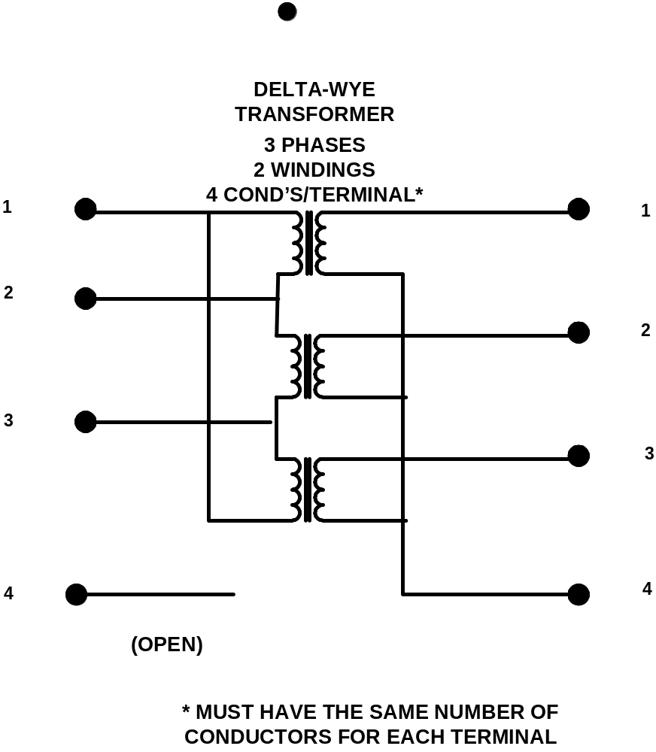
All Terminals of a Circuit Element Have Same Number of Conductors
3-Phase Transformer

Slide 60
Questions I Get ….

Slide 61
How Do You Get Currents and Power If You Only Solve for Node Voltages?
How are the branch currents (and powers) determined when only the Node voltages and Compensation currents are known?
  Currents and powers are determined by post processing the solution
  If the Y matrix is properly formed, the currents will obey Kirchoff’s current law at the nodes
  If convergence is achieved, the powers will be correct

Slide 62
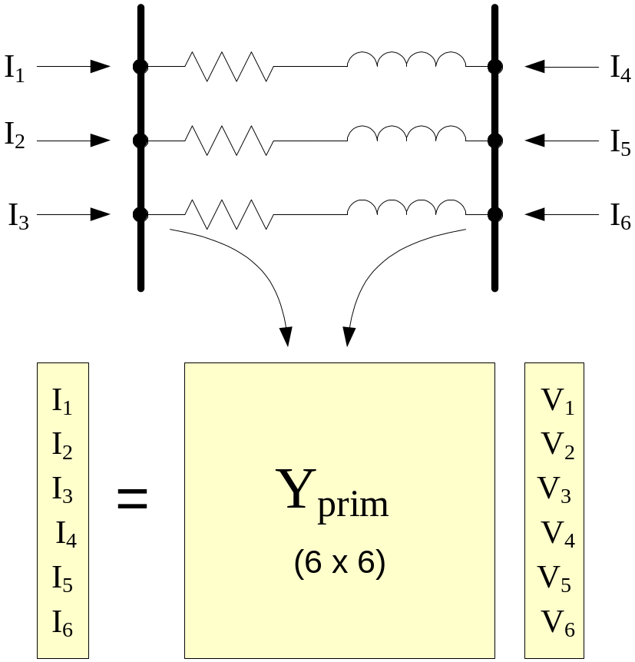
Computing Currents in Branch Terminals (Given the voltages)

Slide 63
Possible Source of Error!
If the branch is extremely short (impedance is very low), currents may be incorrectly computed
  Convergence tolerance is generally 0.0001 pu
  Voltage solution will be good enough
64-bit math is used throughout giving you flexibility
  However, if voltages at both ends of branch are nearly the same, you will be taking the difference between two nearly equal numbers and the multiplying it by a large number (very high conductance)
    This will magnify any error
Do not use impractically short branches

Slide 64
Where Does OpenDSS include Mutual Coupling?
It ALWAYS Includes it!
  All circuit element models provide the DSS executive with an Admittance MATRIX
      That is, every model implicitly has coupled phases
  Units on admittance matrix are actual siemens
    Per units and percent are used for some input and some reports, but not for internal model
    Fewer limitations on the problem that can be represented

Slide 65
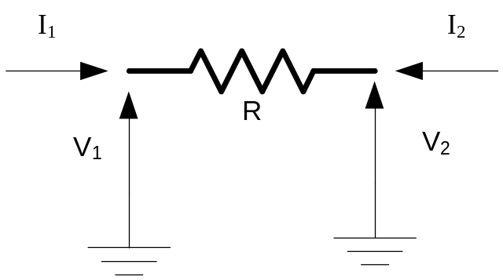
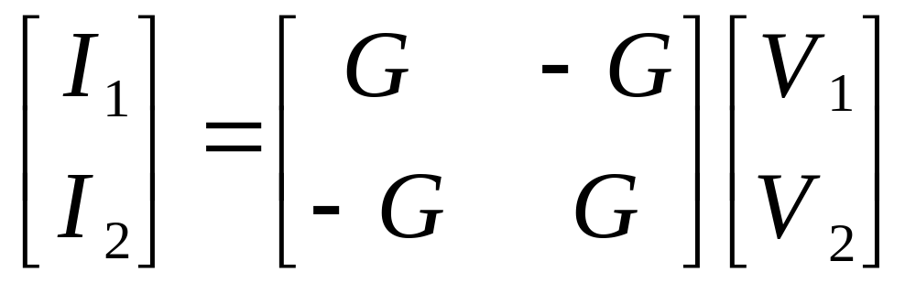
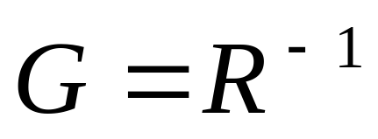
Primitive Y Matrix – A Simple Example
Order of Yprim is
Num Terminals * Num Conductors per Terminal

Slide 66
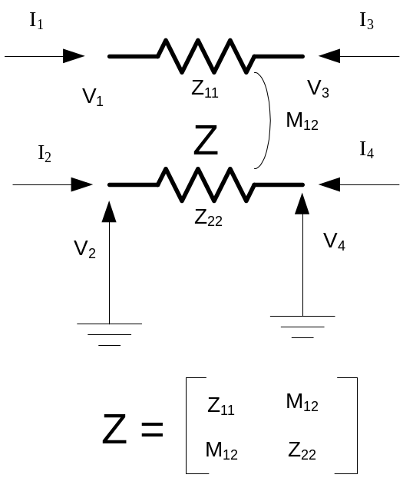
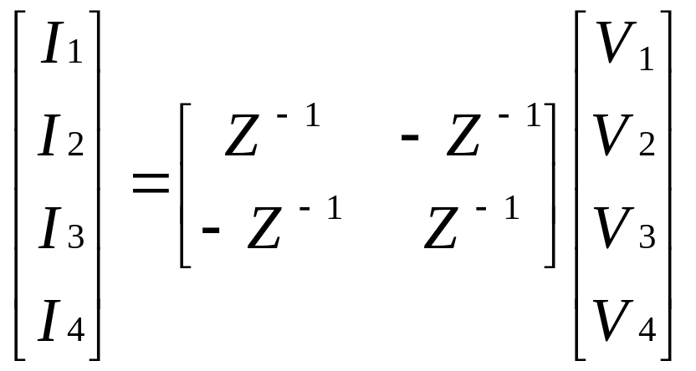
A little more complicated

Slide 67
Yprim
You can obtain the Primitive Y matrix for each element a number of ways (after a Solve)
Dump command
  Dump DSSclass.name debug
    Or, Dump DSSclass.* debug
Script
  Show Yprim ! Of active element
  Export Yprims ! All Yprims
COM Interface
  MyVariant = DSSCircuit.ActiveElement.Yprim

Slide 68
What Kind of Power Flow is the DSS?
The DSS is not a traditional power flow as power engineers tend to think of power flows
  A program with a solution method for fundamental frequency power flow
Its heritage is harmonics analysis and dynamics analysis
  It is a power flow in the sense that you can model loads connected to buses and get a solution that matches traditional power flow programs at 50/60 Hz

Slide 69
What Kind of Power Flow is the DSS?
The “Normal” solution mode is a fixed point iterative solution that works fine for >90% of distribution systems
  Is simple and relatively fast, especially for annual solutions
There is a “Newton” solution method for circuits that are difficult to converge with the Normal method.
  Not to be confused with the traditional Newton-Raphson method in power flow programs
  The Jacobian is the Y matrix, which is not and exact Jacobian, but points in the right direction
    So it is likely to get there eventually

Slide 70
Load and Buses
There is a subtle difference in the way the DSS treats loads that is confusing to traditionally-trained power engineers:
Instead of
  “A Bus has Load”
The DSS has
  “A Load has a Bus”
The latter allows connection of a multitude of different loads and load types to the same bus

Slide 71
Can it solve network systems as well as radial?
The use of the word “Distribution” in the name of the program conjures up ideas of radial circuit solvers in North America (but not necessarily in Europe)
The DSS circuit solver is completely general and has no idea whether the circuit is radial or not.
  This is a requirement for harmonics analysis of distribution systems
The EnergyMeter class is presently the only class that cares about radiality.

Slide 72
Where is the P-V bus type?
Buses do not have special types in the DSS
  Buses are simply connection points for circuit elements
A Generator can control (or attempt to) power and voltage
  (This model can be cantankerous)
This question usually arises with regard to modeling DG on distribution systems
  Fortunately, one seldom needs this model unless the DG is quite large with respect to system capacity
  Most other DG is controlled by Power and Power Factor while interconnected
    Simpler to model

Slide 73
Examples

Slide 74
Storage Example

Slide 75
Script for 75 kWh Simulation
Compile C:\DSSdata\Wes\Colfax\Master.DSS
Redirect AllocateLoadsandMeters.DSS
BusCoords colfax21_EXP_BUSCOORDS.CSV
BusCoords buscoordsCES.DSS ! COORDINATES OF CES LOCATIONS
Set maxcontroliter=20
! ****** ADD STORAGE ***************************
redirect CES.DSS
Redirect Set_For_75kWh.DSS
! DEFINE STORAGE CONTROLLER
New StorageController.CESmain element=line.568_4921721 terminal=1
~ kWTarget=7500 PFTarget=0.98
~ %ratecharge=30
~ eventlog=y
~ modedischarge=follow
! SPECIAL MONITORS
New monitor.Store Storage.jo0211000173 1 mode=1 ppolar=no
New monitor.StoreVars Storage.jo0211000173 1 mode=3
solve
Set Casename=StorageOn75
redirect annualscript.dss
! *************************************************************************
show mon store
show mon storevars
fileedit C:\DSSdata\Wes\Colfax\StorageOn75\DI_yr_1\feeder.csv
Controller Definition

Slide 76
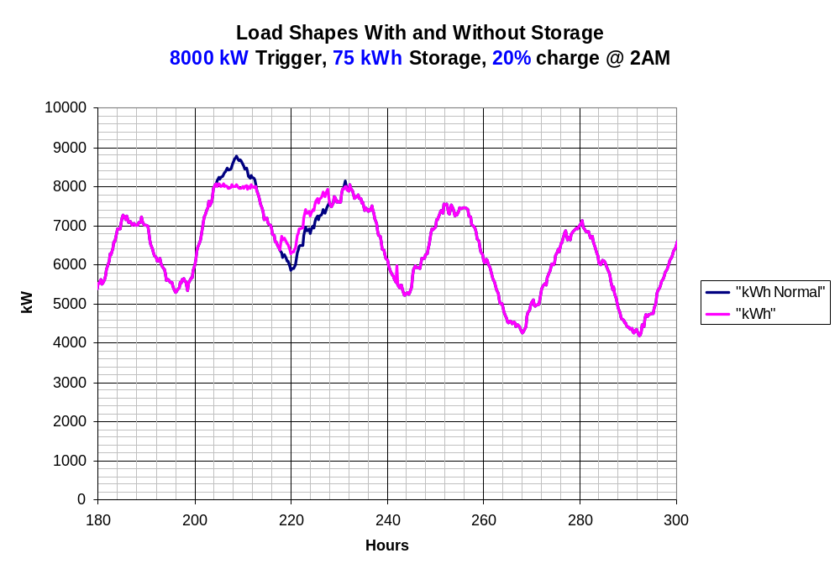
Simple PeakShave Mode

Slide 77
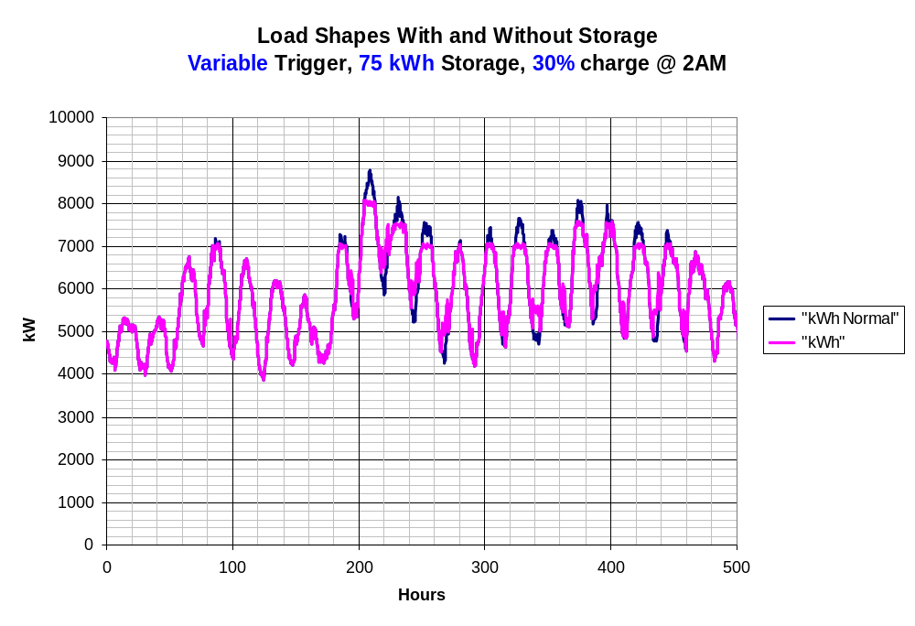
Variable Triggering Simulation
Assumes a Controller that can accurately predict daily load and know when to trigger.

Slide 78
OpenDSS Script for Variable Triggering Example on Previous Slide
! DO PART OF A YEAR IN YEARLY MODE
set mode=yearly stepsize=0.25h
Set overloadreport=true ! TURN OVERLOAD REPORT ON
set voltexceptionreport = true
set demand=true
set DIVerbose=true
Set Year=1
solve number=760
StorageController.CESmain.kWtarget=8000
solve number=120
StorageController.CESmain.kWtarget=7500
solve number=96
StorageController.CESmain.kWtarget=7000
solve number=472
StorageController.CESmain.kWtarget=7500
solve number=200
StorageController.CESmain.kWtarget=7000
solve number=(2784 200 - 472 - 96 - 120 - 760 -) ! Balance of 2784
closeDI

Slide 79
Example:
IEEE 8500-Node
Test Feeder

Slide 80
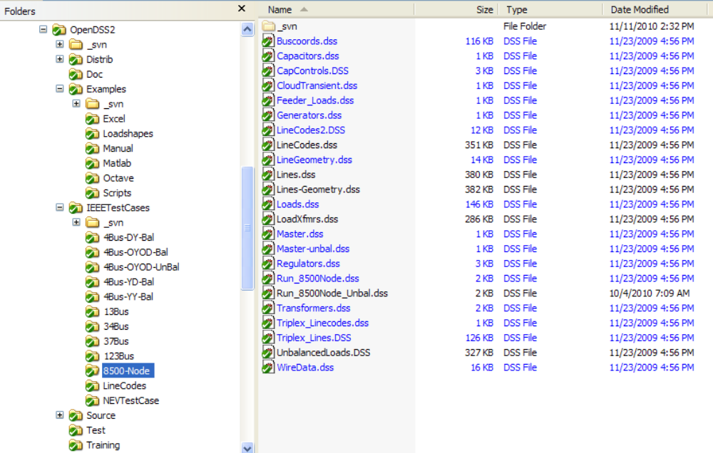
Location

Slide 81
Main Part of Run File
Compile (C:\DSSdata\IEEETest\8500Node\Master-unbal.dss) ! unbalanced load master
New Energymeter.m1 Line.ln5815900-1 1 ! Put an Energymeter at the head of the feeder
Set Maxiterations=20 ! Sometimes the solution takes more than the default 15 iterations
Solve

Slide 82
The Master File
Clear
New Circuit.IEEE8500u
! Make the source stiff with small impedance
~ pu=1.05 r1=0 x1=0.001 r0=0 x0=0.001
Redirect LineCodes2.dss
Redirect Triplex_Linecodes.dss
Redirect Lines.dss
Redirect Transformers.dss
Redirect LoadXfmrs.dss ! Load Transformers
Redirect Triplex_Lines.dss
Redirect UnbalancedLoads.dss
Redirect Capacitors.dss
Redirect CapControls.dss
Redirect Regulators.dss
! Let DSS estimate the voltage bases
Set voltagebases=[115, 12.47, 0.48, 0.208]
Calcvoltagebases ! This also establishes the bus list
! Load in bus coordinates now that bus list is established
Buscoords Buscoords.dss

Slide 83
Solution Summary
Status = SOLVED
Solution Mode = Snap
Number = 100
Load Mult = 1.000
Devices = 7281
Buses = 4876
Nodes = 8561
Control Mode =STATIC
Total Iterations = 62
Control Iterations = 5
Max Sol Iter = 16
- Circuit Summary -
Year = 0
Hour = 0
Max pu. voltage = 1.05
Min pu. voltage = 0.91084
Total Active Power: 12.0452 MW
Total Reactive Power: 1.44513 Mvar
Total Active Losses: 1.27202 MW, (10.56 %)
Total Reactive Losses: 2.8252 Mvar
Frequency = 60 Hz
Mode = Snap
Control Mode = STATIC
Load Model = PowerFlow

Slide 84
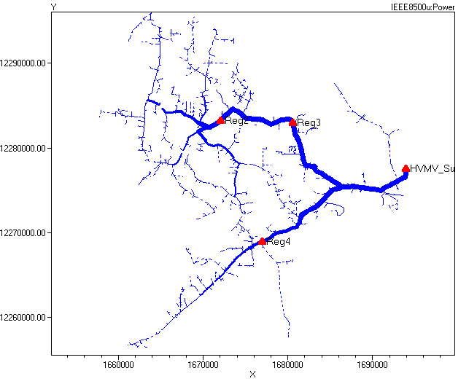
Power Flow Solution Plot
Plot Circuit Power Max=2000 dots=n labels=n subs=y C1=$00FF0000 1ph=3

Slide 85
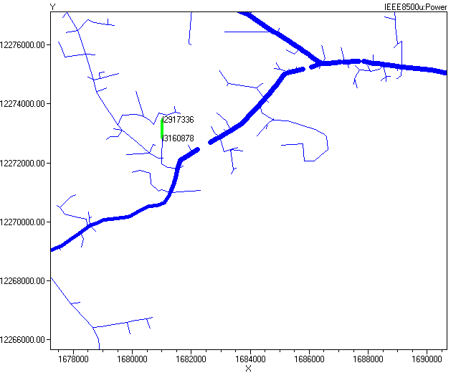
Selecting a Branch from the Plot (Zoomed)

Slide 86
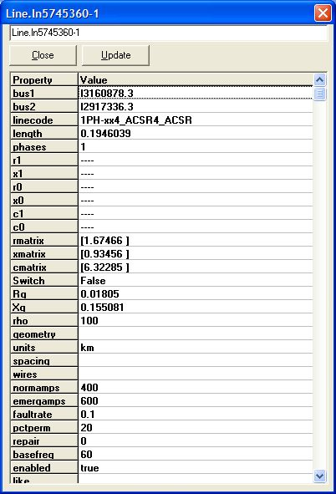
Right-click and select Properties …

Slide 87
Exercise the 8500-Node Test Feeder …
(Class Demo)

Slide 88
Distributed Wind Application Example

Slide 89
Distributed Wind Application
OpenDSS application
  Time-series load/generation representation
  Induction machine modeling
  Wind turbine generator var control
    Mechanically-switched capacitors
    Constant power factor
    Voltage control
  Regulator interaction

Slide 90
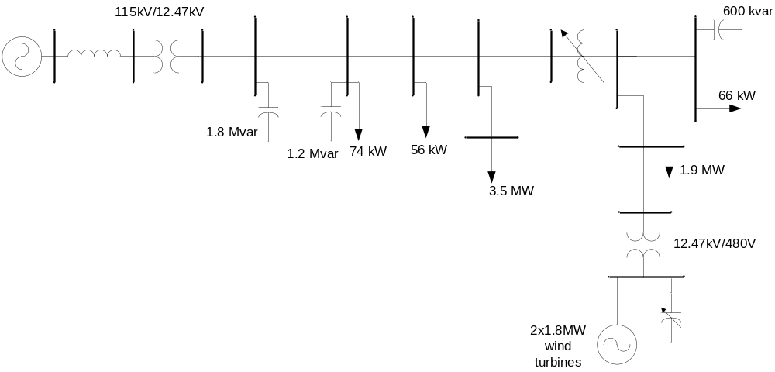
Oneline Diagram

Slide 91
Circuit Definition

Slide 92
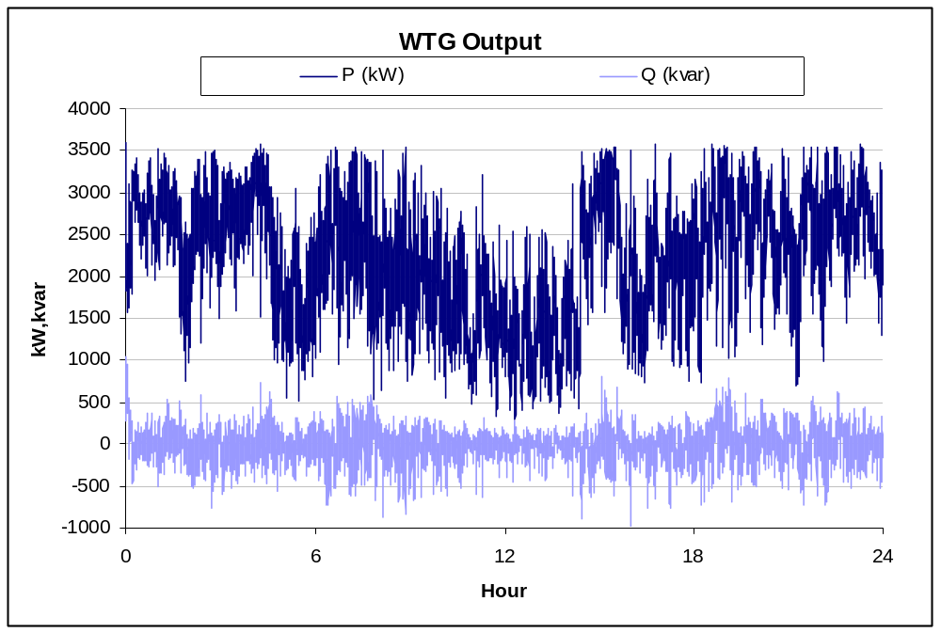
Wind Time Series

Slide 93
Wind Plant Implementation

Slide 94
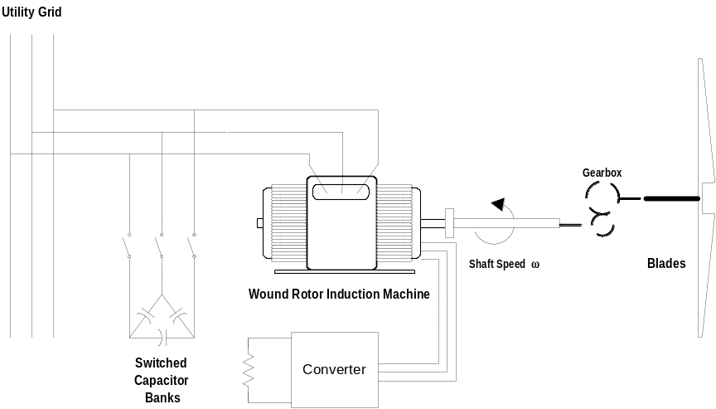
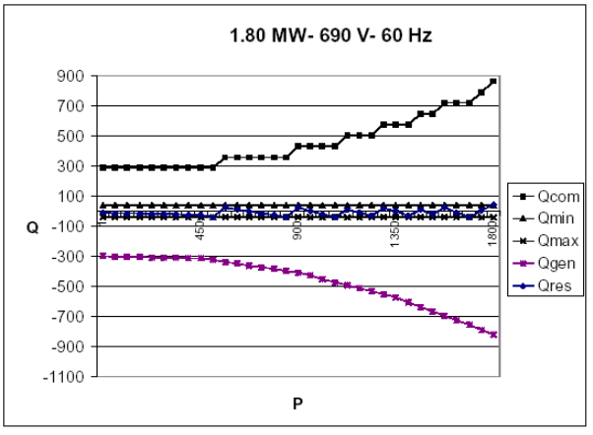
WTG Type 1,2: Capacitor Bank Var Control

Slide 95
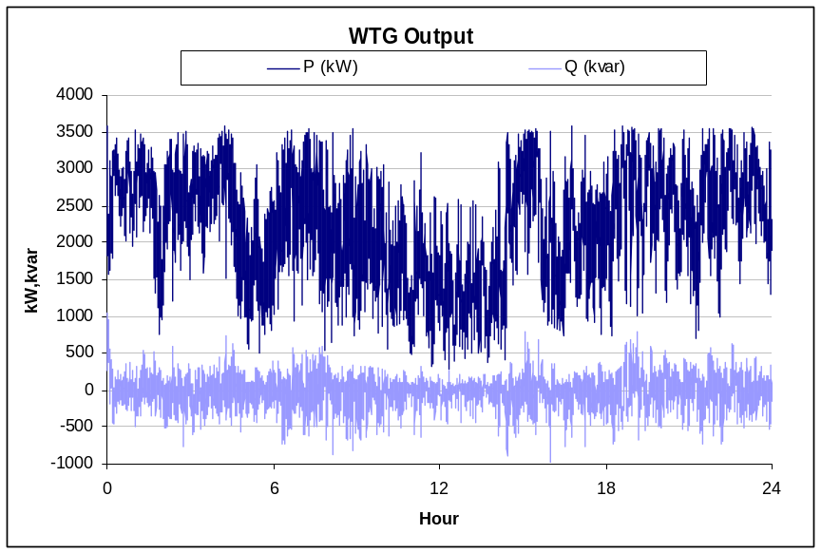


Capacitor Control Results

Slide 96


WTG Type 3,4: “Active” Power Factor Control

Slide 97


Power Factor Control

Slide 98

WTG Type 3,4: Voltage Control
Regulator has no tap operations!!!

Slide 99
Advanced Topics

Slide 100

Registering the COM Server
In DOS window, change to the folder where you installed it and type:
  Regsvr32 OpenDSSEngine.DLL
GUID
The Server shows up as “OpenDSSEngine.DSS” in the Windows Registry

Slide 101

Registering the COM Server, cont’d
If you look up the GUID
Points to OpenDSSEngine.DLL
(In-process server, Apartment Threading model)

Slide 102
Accessing the COM Server
In MATLAB:
  DSSobj = actxserver(‘OpenDSSEngine.DSS’);
In VBA:
  Public DSSobj As OpenDSSEngine.DSS
  Set DSSobj = New OpenDSSEngine.DSS
In PYTHON:
  self.engine = win32com.client.Dispatch("OpenDSSEngine.DSS")

Slide 103
DGScreener Applet
Using the OpenDSS Via the COM Server

Slide 104
DG Screener (Demo)
Developed for EPRI Program 174
  Available to funders
  Funders can download the installation package
Next version planned for 2011
  Expecting users to try it out and suggest changes
  Especially Canadian users
    Concerns are different than US users

Slide 105
Applet Architecture
Main Interfaces Used
DSS
DSSGraph.DLL
Text
IndMach012a.DLL
Circuit
Solution
OpenDSSEngine
DR Screening Applet
DSSProgress
Scripts,
Results
Plot

Slide 106
Driving the OpenDSS via the COM Server from another Application

Slide 107
Active objects concept
There is one registered In-Process COM interface:
  OpenDSSEngine.DSS
    That is, the DSS interface is the one you instantiate
    The DSS interface creates all the others.
The interfaces generally employ the idea of an
ACTIVE object
  Active circuit,
  Active circuit element,
  Active bus, etc.
  The interfaces generally point to the active object
    To work with another object, change the active object.

Slide 108

DSS Interface
This interface is instantiated upon loading OpenDSSEngine.DSS and then instantiates all other interfaces
Call the Start(0) method to initialize the DSS
DSS Class Functions (methods) and Properties

Slide 109
Instantiate the DSS Interface and Attempt a Start
Public Sub StartDSS()
' Create a new instance of the DSS
Set DSSobj = New OpenDSSengine.DSS
' Start the DSS
If Not DSSobj.Start(0) Then
MsgBox "DSS Failed to Start"
Else
MsgBox "DSS Started successfully“
' Assign a variable to the Text interface for easier access
Set DSSText = DSSobj.Text
End If
End Sub

Slide 110

COM Interface
Interfaces as Exposed by VBA Object Browser in MS Excel
Text interface is simplest
Text has two Properties

Slide 111
Assign a Variable to the Text Interface
Public Sub StartDSS()
' Create a new instance of the DSS
Set DSSobj = New OpenDSSengine.DSS
' Start the DSS
If Not DSSobj.Start(0) Then
MsgBox "DSS Failed to Start"
Else
MsgBox "DSS Started successfully“
' Assign a variable to the Text interface for easier access
Set DSSText = DSSobj.Text
End If
End Sub

Slide 112
Now Use the Text Interface …
You can issue any of the DSS script commands from the Text interface
‘ Always a good idea to clear the DSS when loading a new circuit
DSSText.Command = "clear"
' Compile the script in the file listed under "fname" cell on the main form
DSSText.Command = "compile " + fname
‘ Set regulator tap change limits for IEEE 123 bus test case
With DSSText
.Command = "RegControl.creg1a.maxtapchange=1 Delay=15 !Allow only one tap change per solution. This one moves first"
.Command = "RegControl.creg2a.maxtapchange=1 Delay=30 !Allow only one tap change per solution"
.Command = "RegControl.creg3a.maxtapchange=1 Delay=30 !Allow only one tap change per solution"
.Command = "RegControl.creg4a.maxtapchange=1 Delay=30 !Allow only one tap change per solution"
.Command = "RegControl.creg3c.maxtapchange=1 Delay=30 !Allow only one tap change per solution"
.Command = "RegControl.creg4b.maxtapchange=1 Delay=30 !Allow only one tap change per solution"
.Command = "RegControl.creg4c.maxtapchange=1 Delay=30 !Allow only one tap change per solution"
.Command = "Set MaxControlIter=30"
End With

Slide 113
Result Property
The Result property is a Read Only property that contains any result messages the most recent command may have issued.
  Error messages
  Requested values
‘ Example: Query line length
DSSText.Command = “? Line.L1.Length”
S = DSSText.Result ‘ Get the answer
MsgBox S ‘ Display the answer

Slide 114

Circuit Interface
This interface is used to
Get many of the results for the most recent solution of the circuit
Select individual circuit elements in a variety of ways
Select the active bus
Enable/Disable circuit elements

Slide 115
Circuit Interface
Since the Circuit interface is used often, it is recommended that a special variable be assigned to it:
Public DSSCircuit As OpenDSSengine.Circuit
…
DSSText.Command = “Compile xxxx.dss”
Set DSSCircuit = DSSobj.ActiveCircuit
DSSCircuit.Solution.Solve
… ‘ Retrieving array quantities into variants
V = DSSCircuit.AllBusVmagPu
VL =DSSCircuit.AllElementLosses

Slide 116

Solution Interface
The Solution Interface is used to
Execute a solution
Set the solution mode
Set solution parameters (iterations,
control iterations, etc.)
Set the time and time step size

Slide 117
Solution Interface
Assuming the existence of a DSSCircuit variable referencing the Circuit interface
Set DSSSolution = DSSCircuit.Solution
With DSSSolution
…
.LoadModel=dssAdmittance
.dblHour = 750.75
.solve
End With
Use the With statement in VBA to simplify coding

Slide 118

CktElement Interface
This interface provides specific values of the Active Circuit Element
Some values are returned as variant arrays
V = DSSCircuit.ActiveElement.Powers
V = DSSCircuit.ActiveElement.seqCurrents
V = DSSCircuit.ActiveElement.Yprim
Other values are scalars
Name = DSSCircuit.ActiveElement.Name
Nph = DSSCircuit.ActiveElement.NumPhases

Slide 119

Properties Interface
This interface gives access to a String value of each public property of the active element
“Val” is a read/write property

Slide 120
Properties Interface
With DSSCircuit.ActiveElement
  ‘ Get all the property names
  VS = .AllPropertyNames
  ‘ Get a property value by numeric index
  V = .Properties(2).Val
  ‘ Get same property value by name (VS is 0 based)
  V = .Properties(VS(1)).Val
  ‘ Set Property Value by Name
  DSSCircuit.SetActiveElement(“Line.L1”)
  .Properties(‘R1’).Val = “.068”
End With
The last two statements are equivalent to:
DSSText.Command = “Line.L1.R1=.068”

Slide 121

Lines Interface
This interface is provided to iterate through all the lines in the circuit and change the most common properties of Lines.

Slide 122
Example: Setting all LineCodes to a Value
Set DSSLines = DSSCircuit.Lines
. . .
iL = DSSLines.First ‘sets active
Do While iL>0
DSSLines.LineCode = MyNewLineCode
iL = DSSLines.Next ‘ get next line
Loop

Slide 123
VBA Example
Option Explicit
Public DSSobj As OpenDSSengine.DSS
Public DSSText As OpenDSSengine.Text
Public DSSCircuit As OpenDSSengine.Circuit
Public Sub StartDSS()
' Create a new instance of the DSS
Set DSSobj = New OpenDSSengine.DSS
' Assign a variable to the Text interface for easier access
Set DSSText = DSSobj.Text
' Start the DSS
If Not DSSobj.Start(0) Then MsgBox "DSS Failed to Start"
End Sub
Define some public variables that are used throughout the project
This routine instantiates the DSS and starts it. It is also a good idea at this time to assign the text interface variable.

Slide 124
VBA Example
Public Sub LoadCircuit(fname As String)
' Always a good idea to clear the DSS when loading a new circuit
DSSText.Command = "clear"
' Compile the script in the file listed under "fname" cell on the main form
DSSText.Command = "compile " + fname
' The Compile command sets the current directory the that of the file
' Thats where all the result files will end up.
' Assign a variable to the Circuit interface for easier access
Set DSSCircuit = DSSobj.ActiveCircuit
End Sub
This subroutine loads the circuit from the base script files using the Compile command through the Text interface. “fname” is a string contains the name of the master file.
There is an active circuit now, so assign the DSSCircuit variable.

Slide 125
VBA Example
Public Sub LoadSeqVoltages()
' This Sub loads the sequence voltages onto Sheet1 starting in Row 2
Dim DSSBus As OpenDSSengine.Bus
Dim iRow As Long, iCol As Long, i As Long, j As Long
Dim V As Variant
Dim WorkingSheet As Worksheet
Set WorkingSheet = Sheet1 'set to Sheet1 (target sheet)
iRow = 2
For i = 1 To DSSCircuit.NumBuses ' Cycle through all buses
Set DSSBus = DSSCircuit.Buses(i) ' Set ith bus active
' Bus name goes into Column 1
WorkingSheet.Cells(iRow, 1).Value = DSSCircuit.ActiveBus.Name
' Load sequence voltage magnitudes of active bus into variant array
V = DSSBus.SeqVoltages
' Put the variant array values into Cells
' Use Lbound and UBound because you don't know the actual range
iCol = 2
For j = LBound(V) To UBound(V)
WorkingSheet.Cells(iRow, iCol).Value = V(j)
iCol = iCol + 1
Next j
iRow = iRow + 1
Next i
End Sub
This Sub puts the sequence voltage onto a spreadsheet
Define a variable for the Bus interface
Define a variant to pick up the arrays
Cycle through all the buses
Get the bus name
Get the voltages into the variant array
Put them on the spreadsheet

Slide 126
Running OpenDSS From Matlab
Starting the DSS
%Start up the DSS
[DSSStartOK, DSSObj, DSSText] = DSSStartup;
function [Start,Obj,Text] = DSSStartup
% Function for starting up the DSS
%
%instantiate the DSS Object
Obj = actxserver('OpenDSSEngine.DSS');
%
%Start the DSS. Only needs to be executed the first time w/in a
%Matlab session
Start = Obj.Start(0);
% Define the text interface to return
Text = Obj.Text;

Slide 127
Using the DSS through the DSSText Interface from Matlab (harmonics example)
%Compile the DSS circuit script
DSSText.Command = 'compile master.dss';
% get an interface to the active circuit called "DSSCircuit"
DSSCircuit = DSSObj.ActiveCircuit;
%Determine which connection type for the source and call
%appropriate DSS file
switch XFMRType
case 1
DSSText.Command = 'redirect directconnectsource.DSS';
case 2
DSSText.Command = 'redirect deltadelta.DSS';
case 3
DSSText.Command = 'redirect deltawye.DSS';
otherwise
disp('Unknown source Connection Type')
end
%Set the system frequency and vsource frequency for harmonic requested
DSSText.Command = ['set frequency=(' num2str(Freq) ' 60 *)'];
DSSText.Command = ['vsource.source.frequency=(' num2str(Freq) ' 60 *)'];

Slide 128
Using the DSS through the DSSText Interface from Matlab (harmonics example) (cont’d)
% Vary the parameters according to a random distribution
% If more parameters need to be varied, just add them to the below
% list. Set ParamNum to total number of parameters varied
ParamNum = 6; %ParamNum used for sorting/plotting
for Case_Count = 1:Max_Cases
%Create index in the OutputData matrix to keep the cases in order
OutputData(Case_Count,1) = Case_Count;
% Generate random new coordinates for each conductor
[x1 y1 x2 y2 x3 y3 geomean] = RandomGeometry(8,0.75,30);
(... etc. etc. )
%define a new line geometry with random spacing
DSSText.Command = ['New LineGeometry.OHMOD nconds=3 nphases=3 cond=1 wire=acsr336 x=' num2str(x1) ' ' num2str(y1) ' units=ft cond=2 wire=acsr336 x=' num2str(x2) ' ' num2str(y2) ' units=ft cond=3 wire=acsr336 x=' num2str(x3) ' ' num2str(y3) ' units=ft'];
%Solve the circuit
DSSText.Command = 'solve';
(etc. etc.)

Slide 129
Power Flow Solution Basics

Slide 130
Solving the Power Flow
Once the circuit model is connected properly the next step is to solve the base power flow
Power Conversion elements (PC elements) are often nonlinear
Load are converted to a Norton equivalent based on nominal 100% rated voltage.
  Current source is “compensation current”
A fixed point solution algorithm is employed for most solutions
This method allows for flexible load models and is fairly robust for most distribution systems

Slide 131
Solving the Power Flow, cont’d
This solution method requires that the first guess at the voltages be close to the final solution
  Not a problem for daily or yearly simulations
  First solution is often most difficult
The solution initialization routine in OpenDSS accomplishes this in most cases
Method works well for arbitrary unbalances
For conditions that are sensitive, a Newton method is provided that is more robust, but slower.

Slide 132

Load (a PC Element)
General Concept
Added into Injection Current Vector
Goes into System Y Matrix
(One-Line Diagram)
Most Power Conversion (PC) Elements are Modeled Like This

Slide 133
Load - 3-phase Y connected
Phase 1
1
2
Phase 2
3
4 Conductors/Terminal
Phase 3
4

Slide 134
Load - 3-phase Delta connected
Phase 1
2
1
Phase 2
3
3 Conductors/Terminal
Phase 3

Slide 135
Putting it All Together
ALL Elements
Yprim 1
Yprim 2
Yprim 3
Yprim n
PC Elements
Comp. Currents
I1
I2
Y
Node
Voltages
I_{inj}
=
V
Im
Iteration Loop

Slide 136
Putting it All Together
Th-Th-That's All Folks !
ALL Elements
Yprim 1
Yprim 2
Yprim 3
Yprim n
PC Elements
Comp. Currents
I1
I2
Y
Node
Voltages
I_{inj}
=
V
Im
Iteration Loop

Slide 137
Solution Speed
Distribution systems generally converge very well
  Many transmission systems, also
The OpenDSS program seems to be on par with the faster commercial programs
Solution method is designed to run annual simulations
Our philosophy:
    Err on the side of running more power flow simulations
      Don’t worry about the solution time until it proves to be a problem
      This reveals more information about the problem

Slide 138
References
OpenDSS Tech Notes: http://sourceforge.net/apps/mediawiki/electricdss/index.php?title=List_of_DSS_tech_notes
OpenDSS Forum:
http://sourceforge.net/projects/electricdss/forums/forum/861976
Frequently-Asked Questions:
http://www.rogerdugan.com/OpenDSS/sourceforgelinks.html
Main Documentation Area:
http://electricdss.svn.sourceforge.net/viewvc/electricdss/Doc/

